Slide 1
Michael F. Price Student Investment Fund MPSIF Information Session April 10, 2024
Anthony Marciano
Clinical Professor of Finance

Slide 2
What is MPSIF?
It’s a class, formally
FINC-GB.3320, “Managing Investment Funds”
But not an ordinary class. It’s
“Hands-On”
“Experiential”
“Learning-by-Doing”
Admission is limited. By application only. Due April 23rd and you will be notified about a week or so later.

Slide 3
What’s Special About MPSIF?
The structure
3.0 credits, 3 hours per week – But 2 semester commitment (spring/fall or fall/spring)
Looking into optional 1.5 credits in second term
Why? Continuity in management of real money.
The deliverables
Financial writing, oral presentations, financial decisions in a group setting
The goals
Honing analytical and presentation skills
Deeper understanding of governance and fiduciary responsibilities in running an endowment fund

Slide 4
What Happens in MPSIF?
Students manage real money, now $2-3 million of NYU endowment
Students work in teams (4 funds) that manage separate pools of equity and fixed income investments
Students perform all of the key tasks
Economic, sector and company research
Stock selection, buys & sells, monitoring
Fiduciary duties – Proxy votes, minutes, Annual Report(s), Board presentations

Slide 5
What Else You Can Expect
Short talks from Professor overseeing the course
Guest speakers from industry including fund managers and investment strategists
Presentations to an outside board of professionals
Functional Group work on volunteer basis in Analytics and Asset Allocation etc
Working with Stern School officials in Dean’s office, Investment Committee, Public Affairs, Development, and Alumni Affairs to help showcase Stern and MPSIF

Slide 6
How are the Funds Run?
Students run MPSIF, but within limits. There are some “Rules of the Game.”
MPSIF is a long-only endowment fund.
Permitted securities include: Stocks, bonds, money market instruments, and limited mutual funds and ETFs. NYU is a tax-exempt institution.
Goals include (a) returns in excess of inflation over a 3-5 year period, (b) returns exceeding an appropriate benchmark, (c) a focus on long-term opportunities rather than short-term trading gains, (d) an acceptable level of diversification.

Slide 7
Fund Portfolios
Growth vs Russell 1000 Growth
Value vs Russell 1000 Value
ESG vs S&P500
Fixed Income vs Vanguard Total Bond Market Index Fund (VBMFX)
Examples on next slides
Refer to Website NYUMPSIF.com for performance and other information
Detailed information in Annual Report generated each term

Slide 8
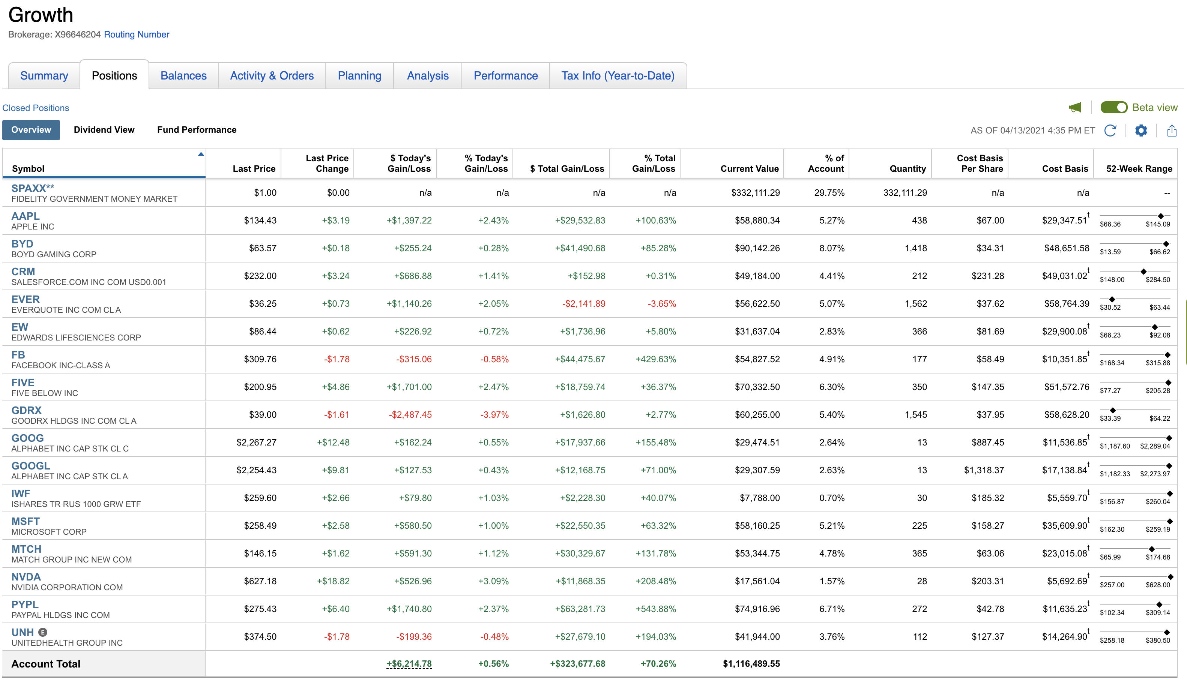

Slide 9
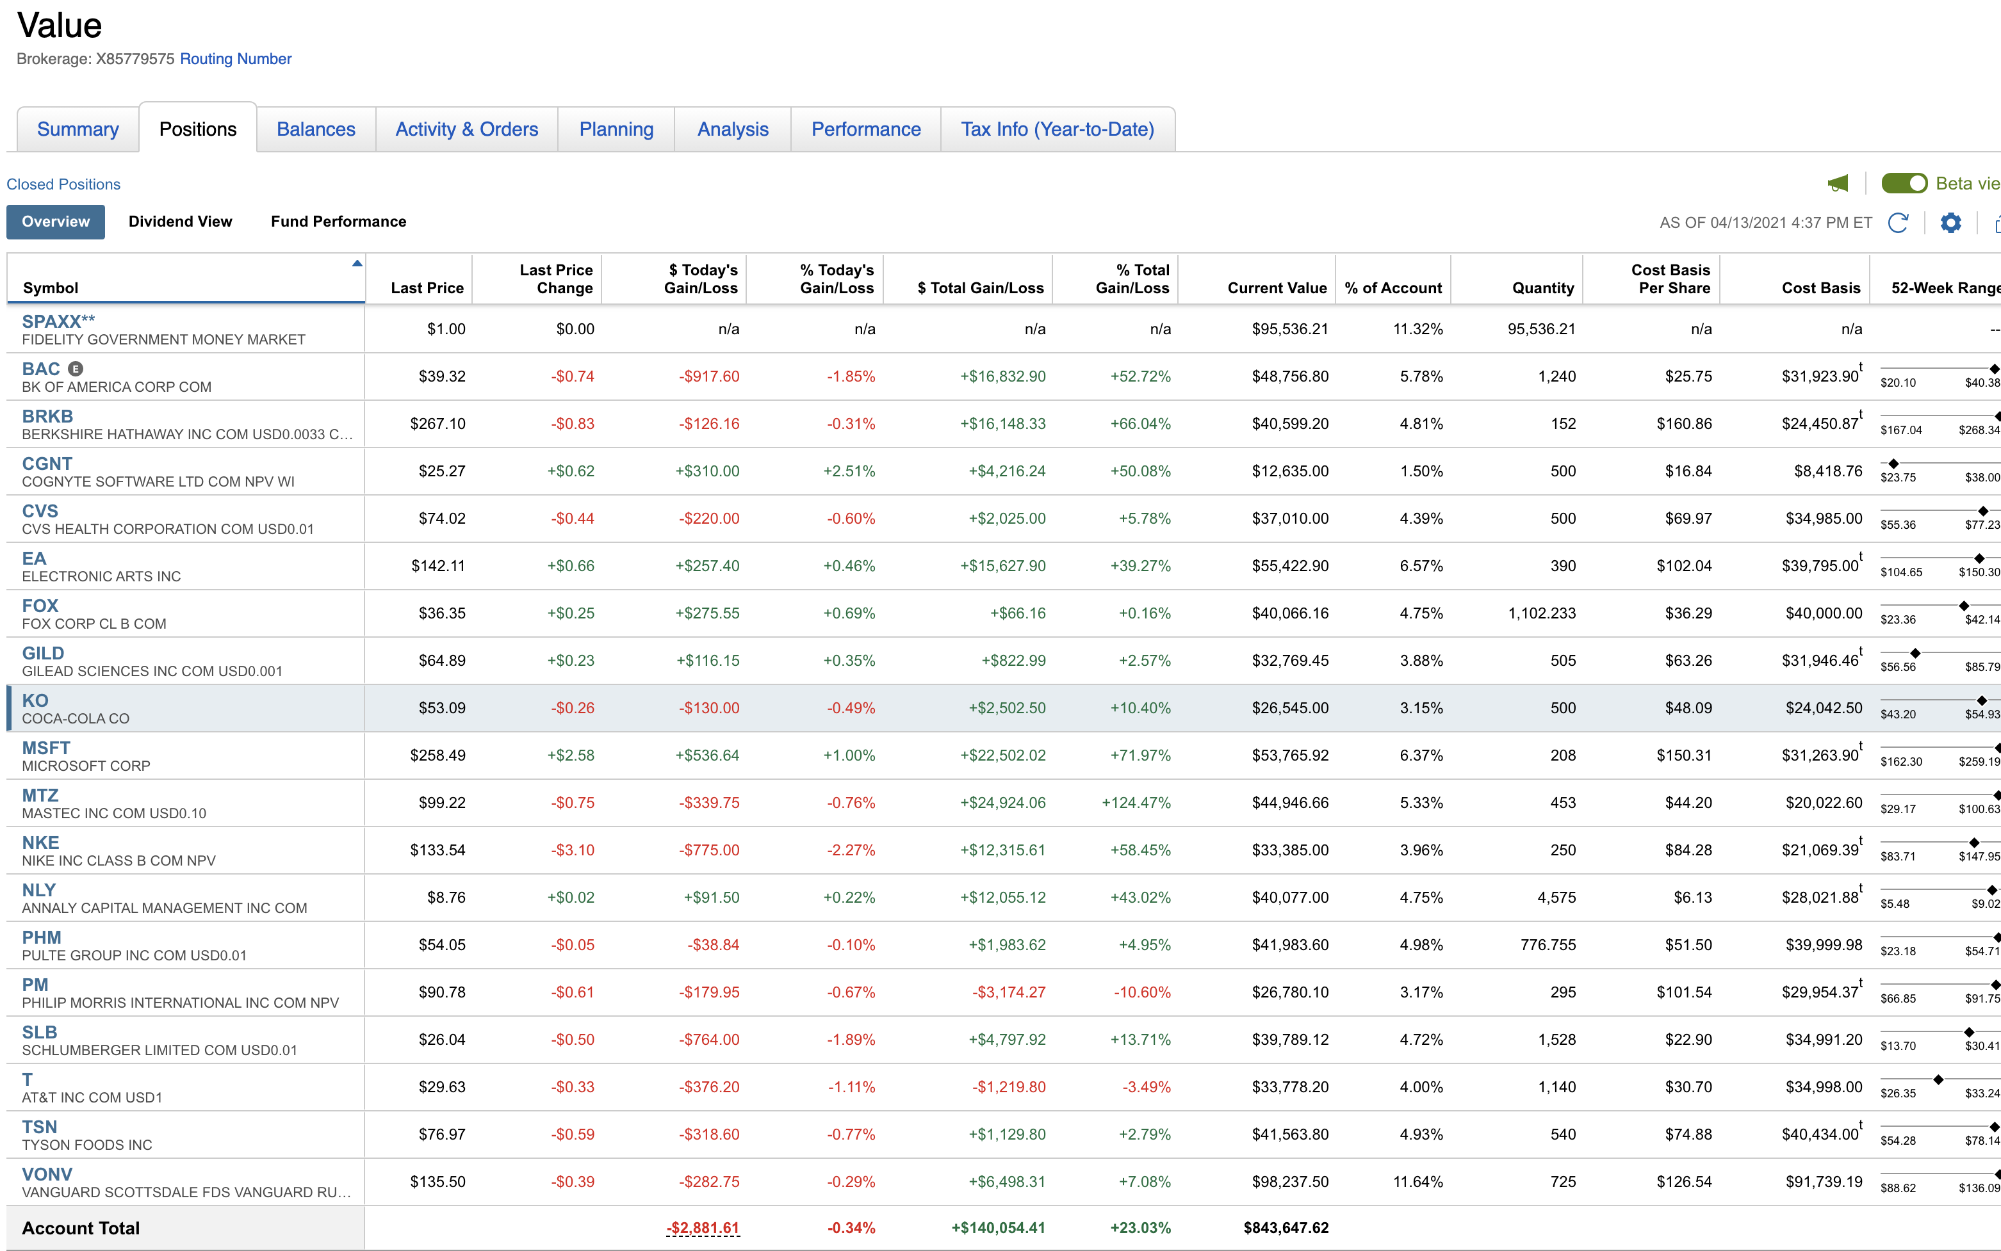

Slide 10
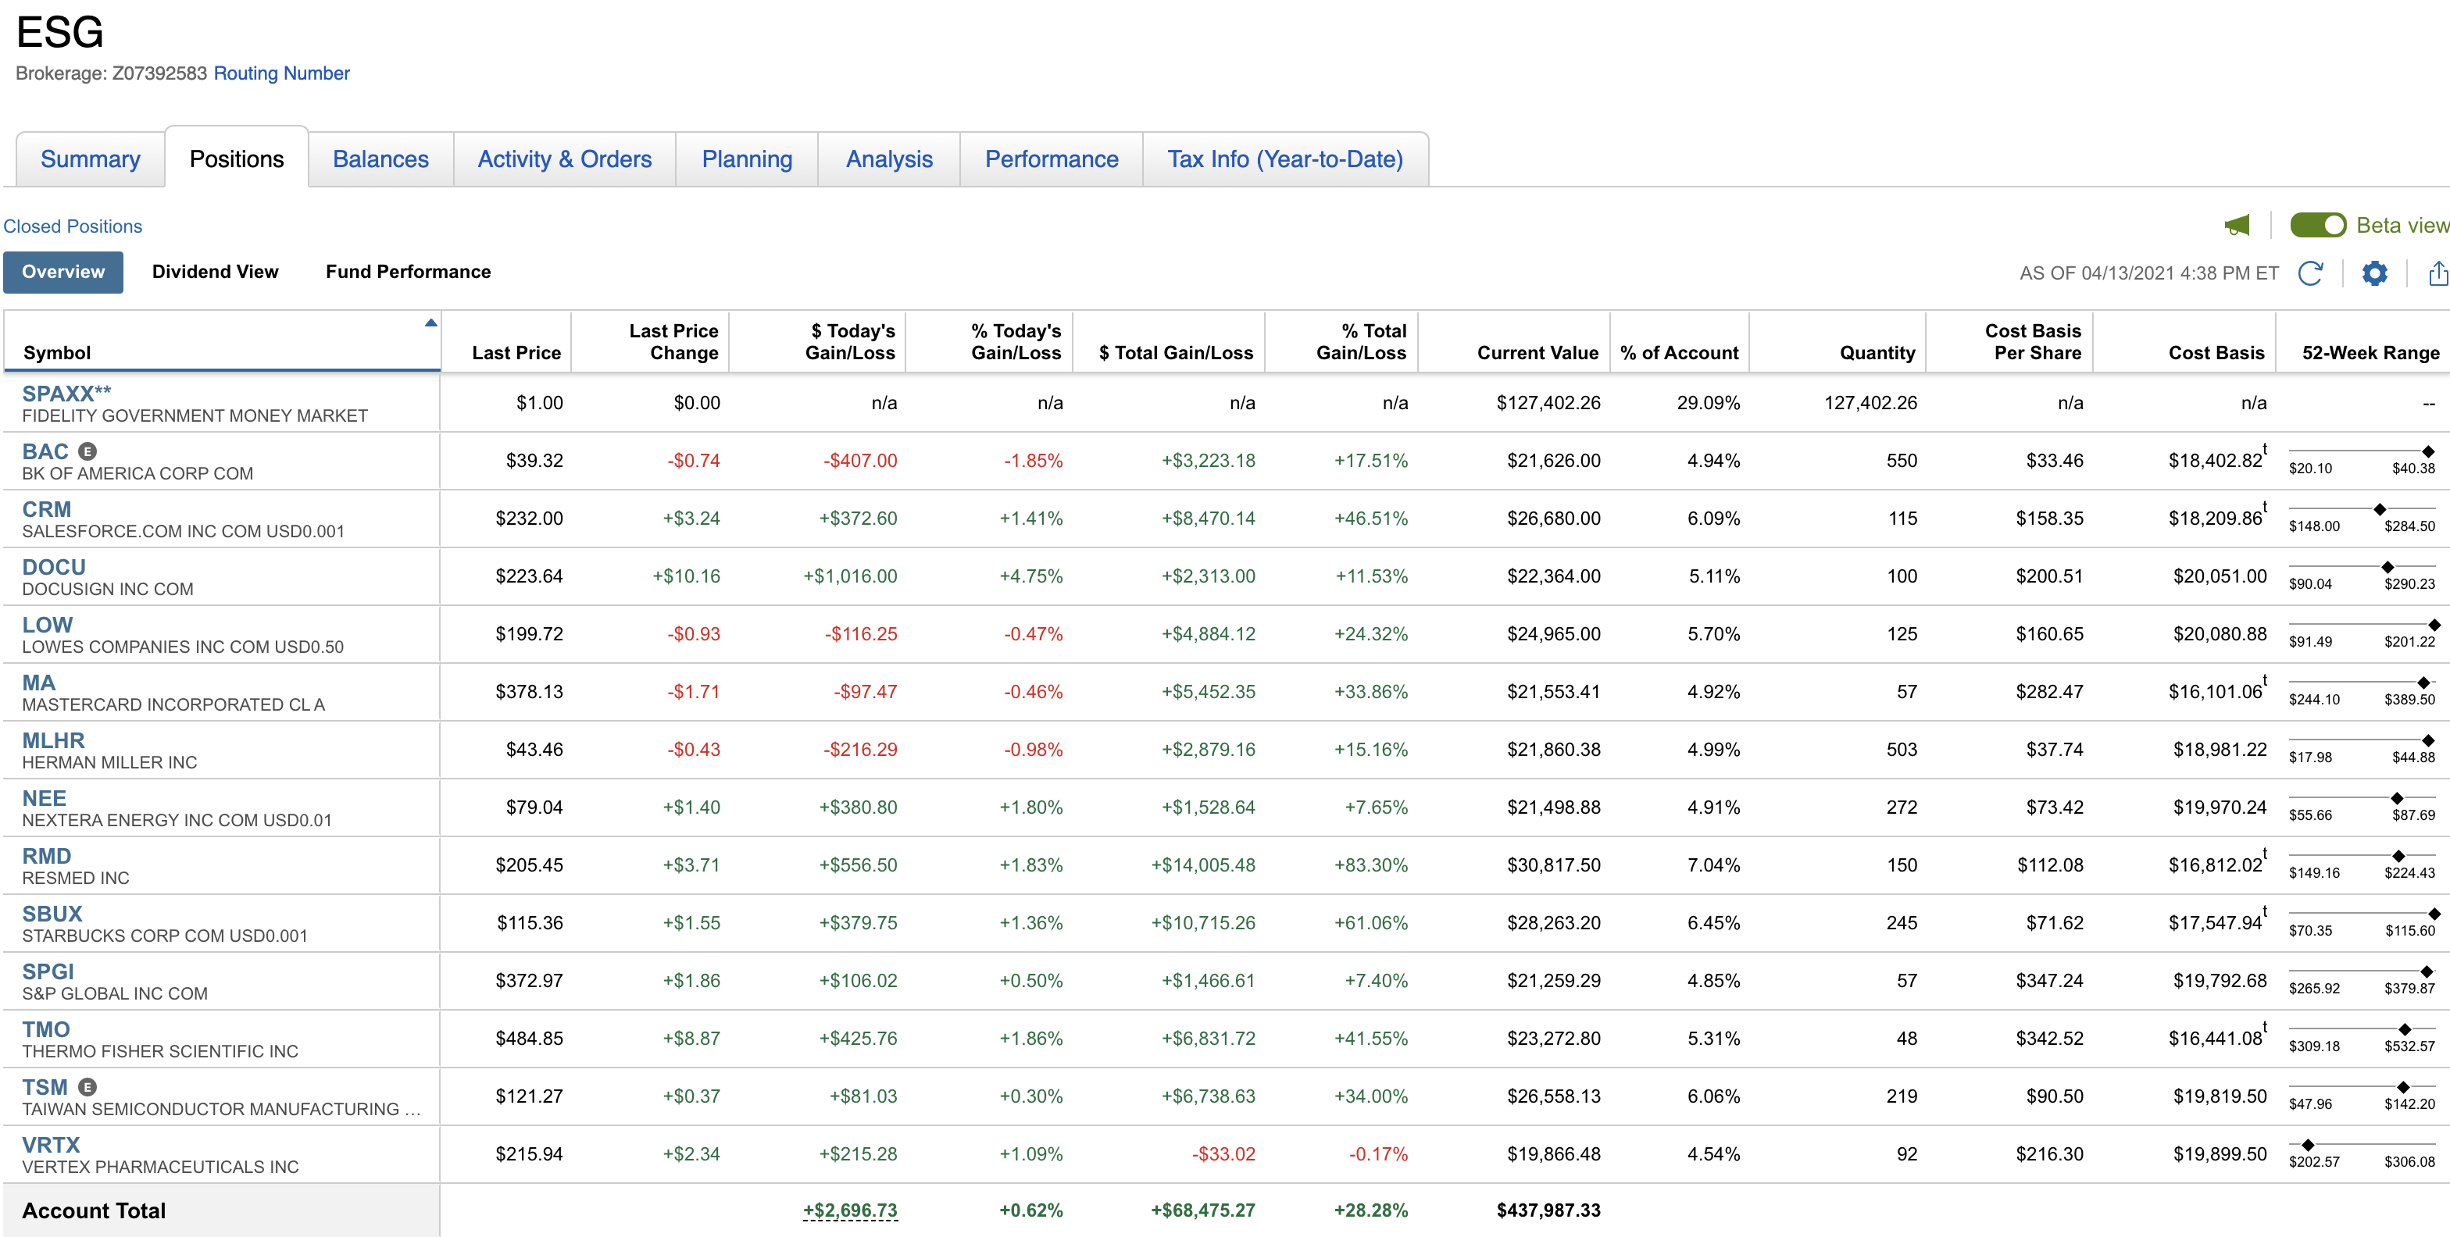

Slide 11
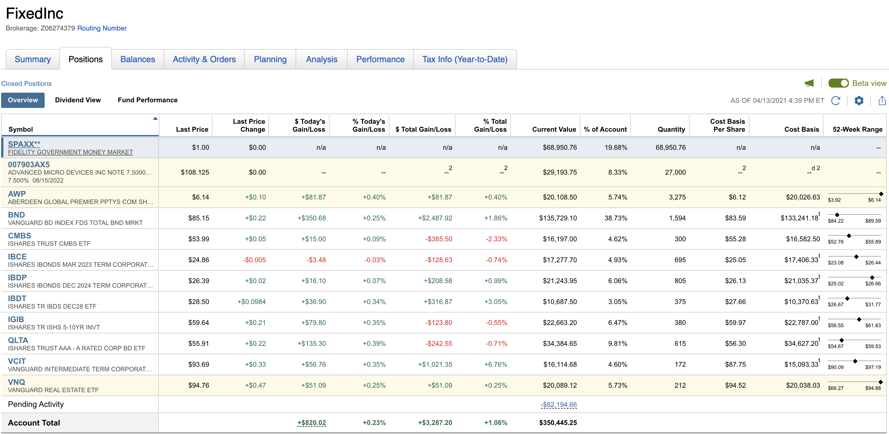

Slide 12
How Do I Join MPSIF?
Submit an application (to amarcian@stern.nyu.edu)
Submit a letter that
Describes your qualifications and explains why you desire to join the MPSIF.
Describes the contributions you can make to MPSIF and what you expect to gain by participating in the Fund.
Notes whether you have taken Foundations of Finance and whether you have taken, or intend to take Valuation.
Attach your current resume

Slide 13
Final Thoughts on Applying to MPSIF
Open to Day MBAs and Langones
Foundations is required
Corporate and/or Valuation are helpful
Not just for Finance majors – This is a capstone course for anyone who wants a hands-on style course, and enjoys learning-by-doing in a less-structured setting.
To learn more, visit http://www.nyumpsif.com

